Slide 1
Database Project
Bramitha Mindahalli Ramakrishna – 1270907
DAMON TIAN- 1260476
GE DING- 1264266

Slide 2
Contents :
1. Software's Used
2. User Interface design
3. Database Design
4. Coding

Slide 3
Software’s USED :
HTML – Hypertext Mark-up Language is used for documents designed to be displayed in a web browser.
CSS (Tailwind CSS) - A utility-first CSS framework for rapidly building custom user interfaces.
JavaScript (alpine.js) - Alpine.js is a rugged, minimal framework for composing JavaScript behaviour in to mark-up.
Laravel PHP - Full stack framework for developing application, used to connect the SQLite file to the website(html). Laravel PHP's ORM is used to translate raw SQL queries to work with the database.
SQLite – It is a C-language library that implements a small, fast, self-contained, high-reliability, full-featured, SQL database engine.

Slide 4
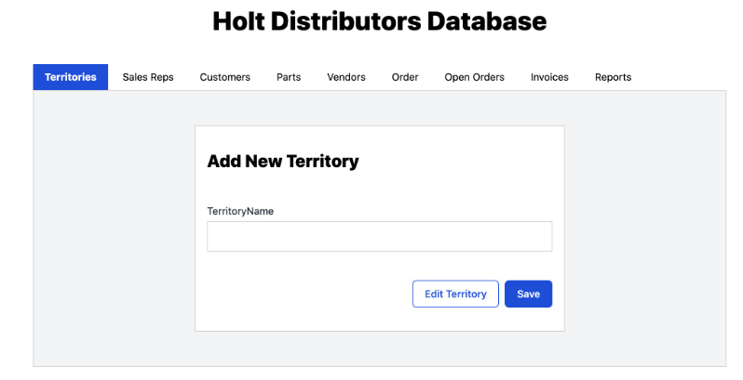
User Interface Design :
Territories – Here Territory number is auto generated in DB, name is entered from browser.

Slide 5
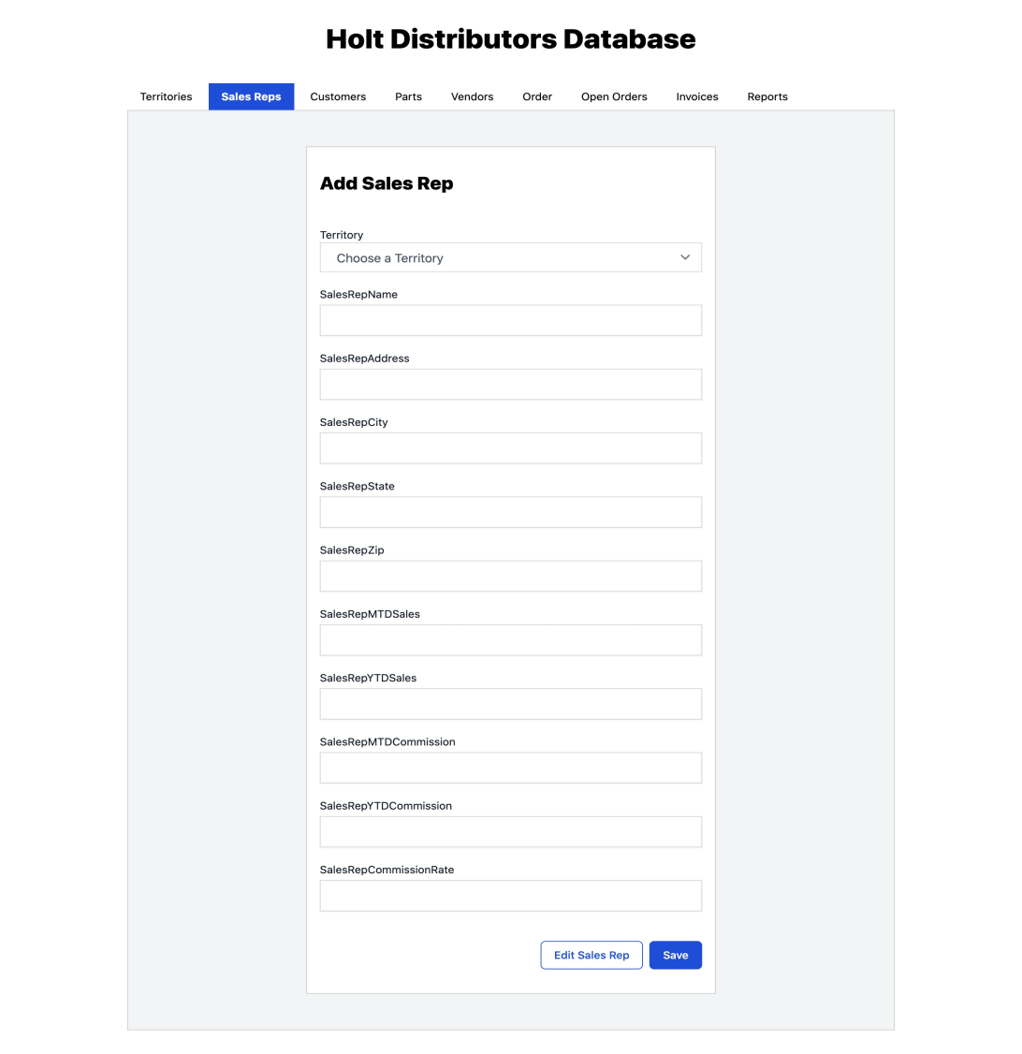
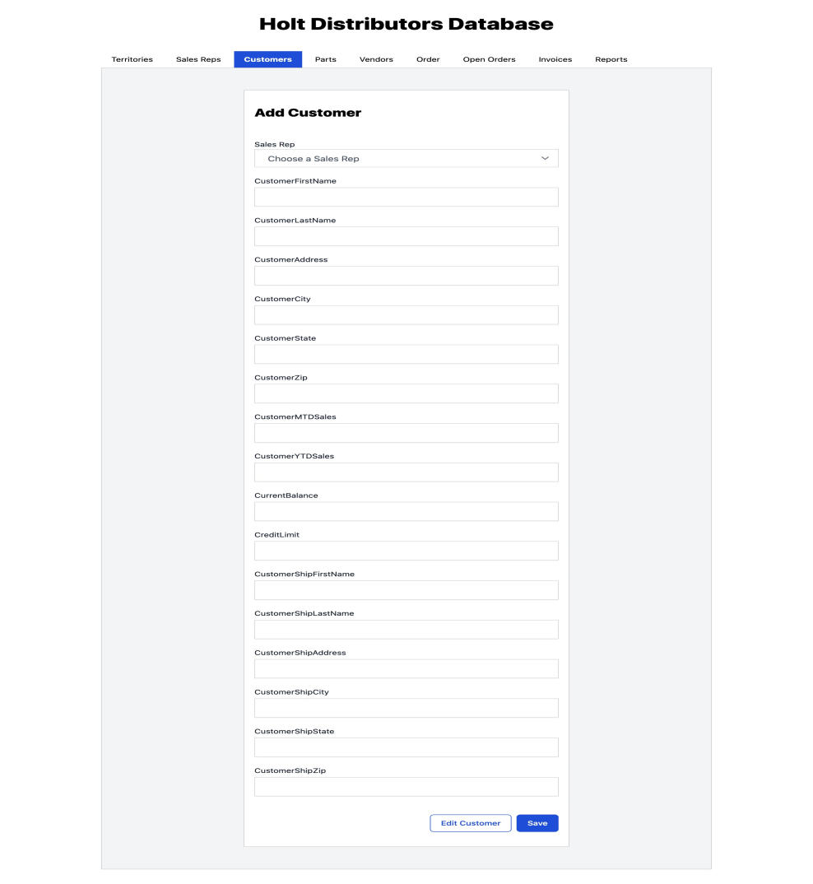

Slide 6
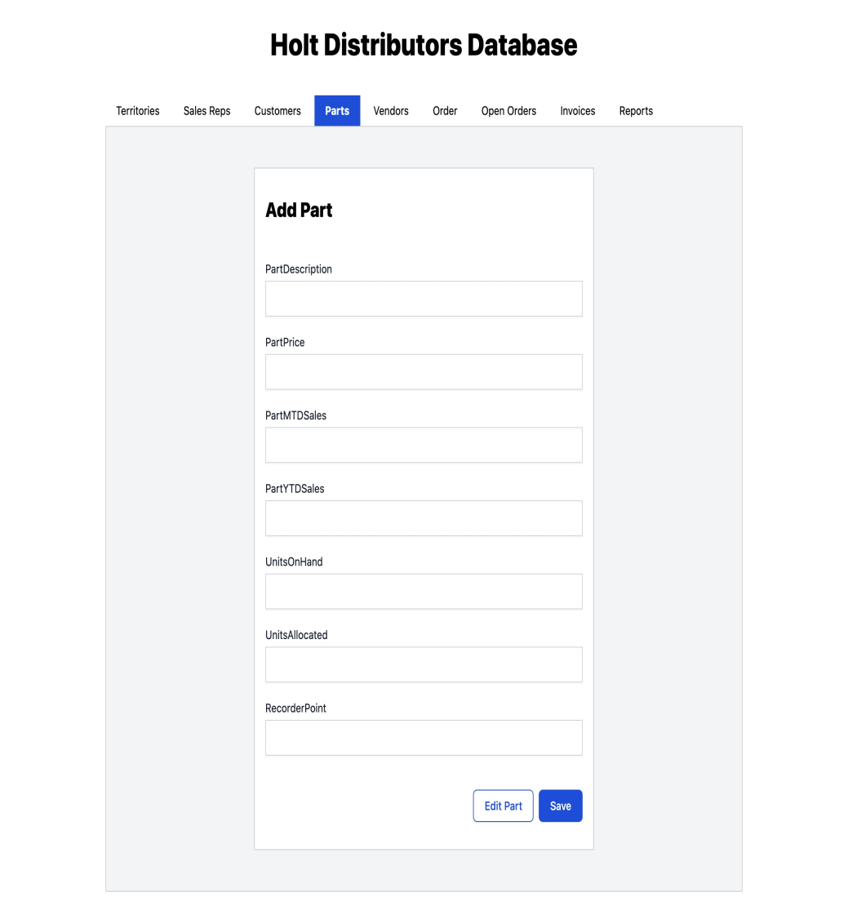
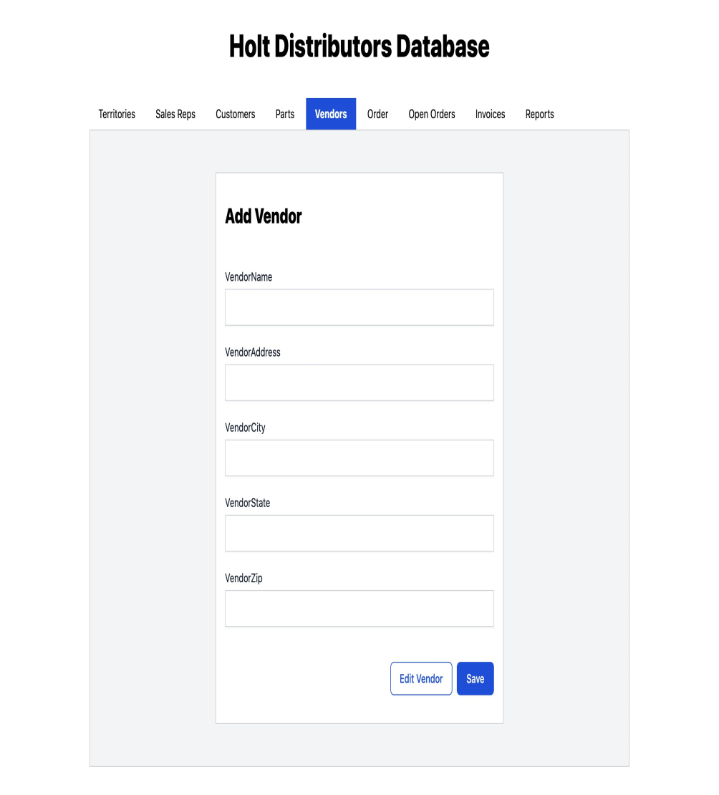

Slide 7
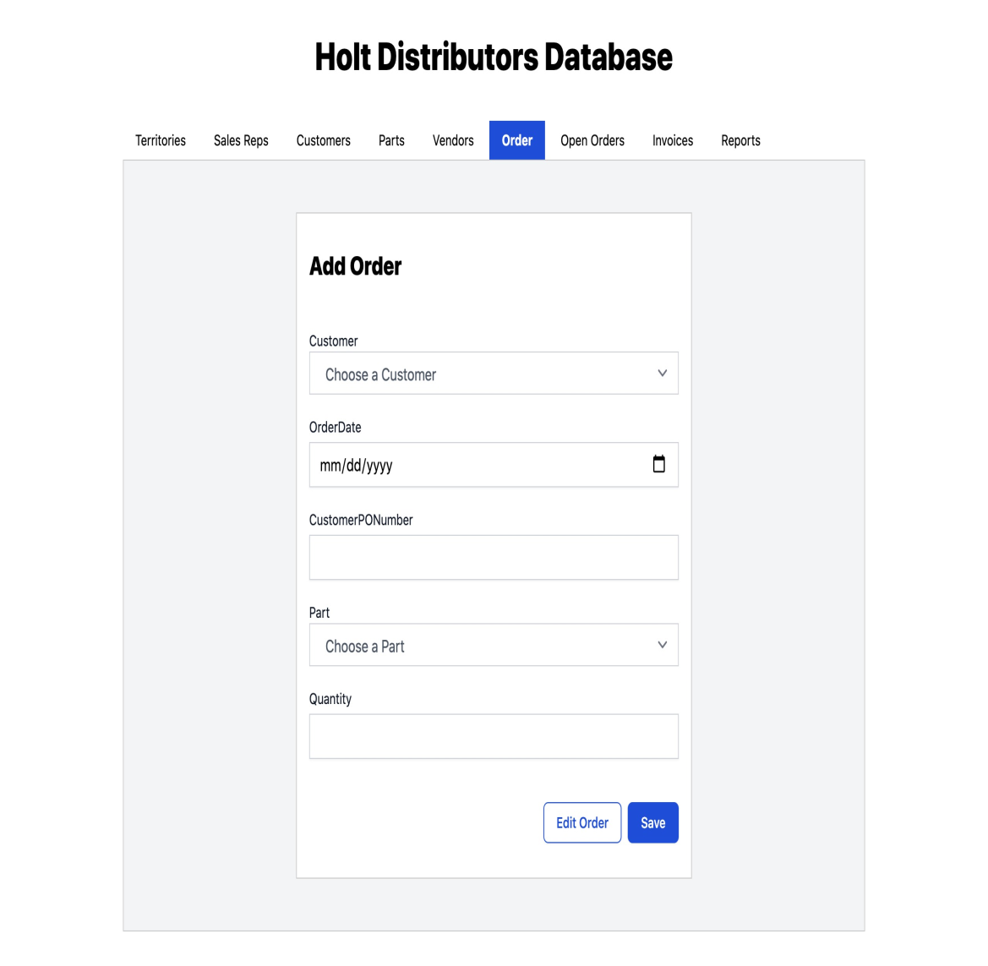
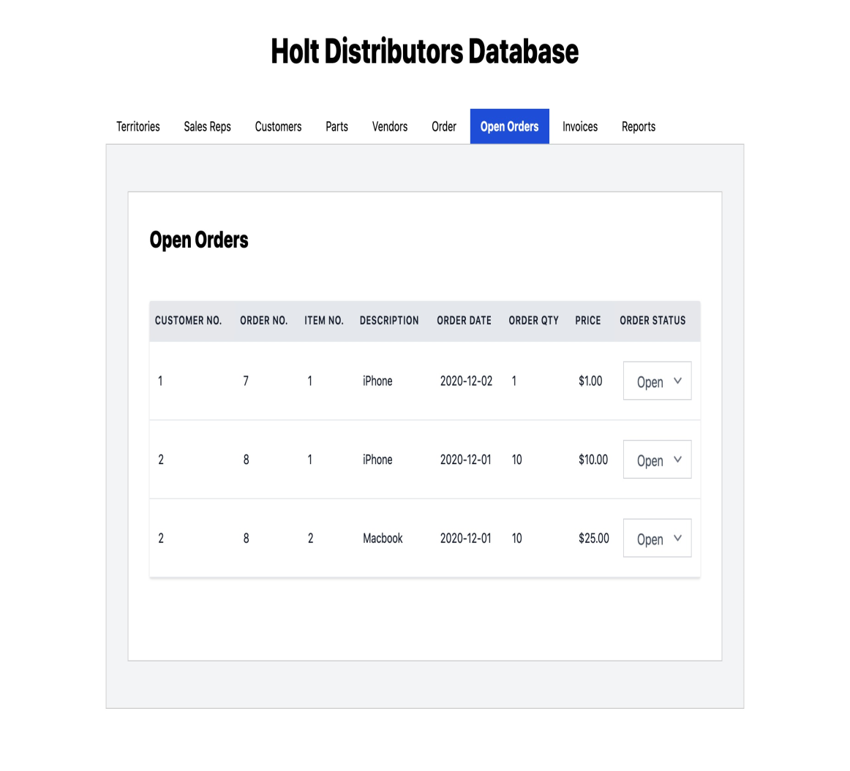

Slide 8
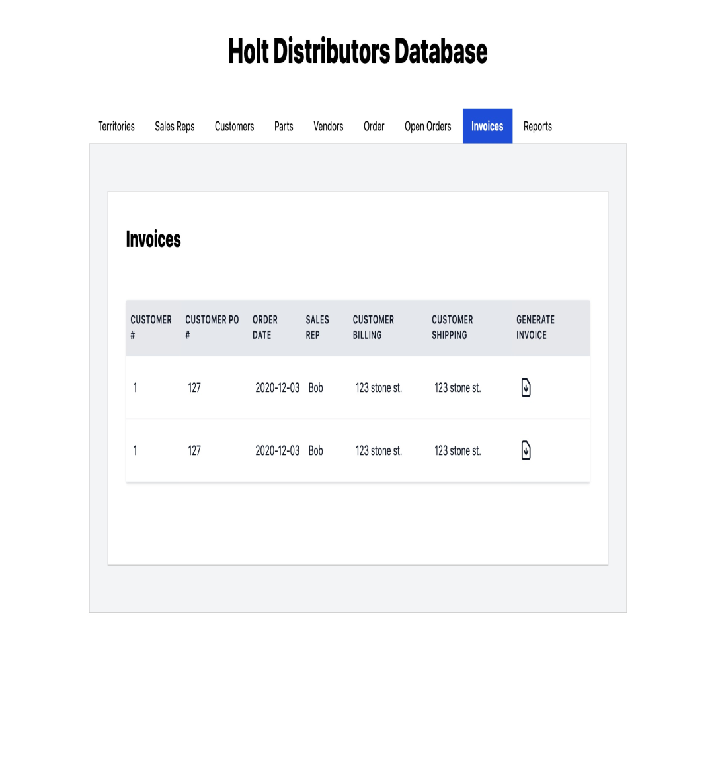
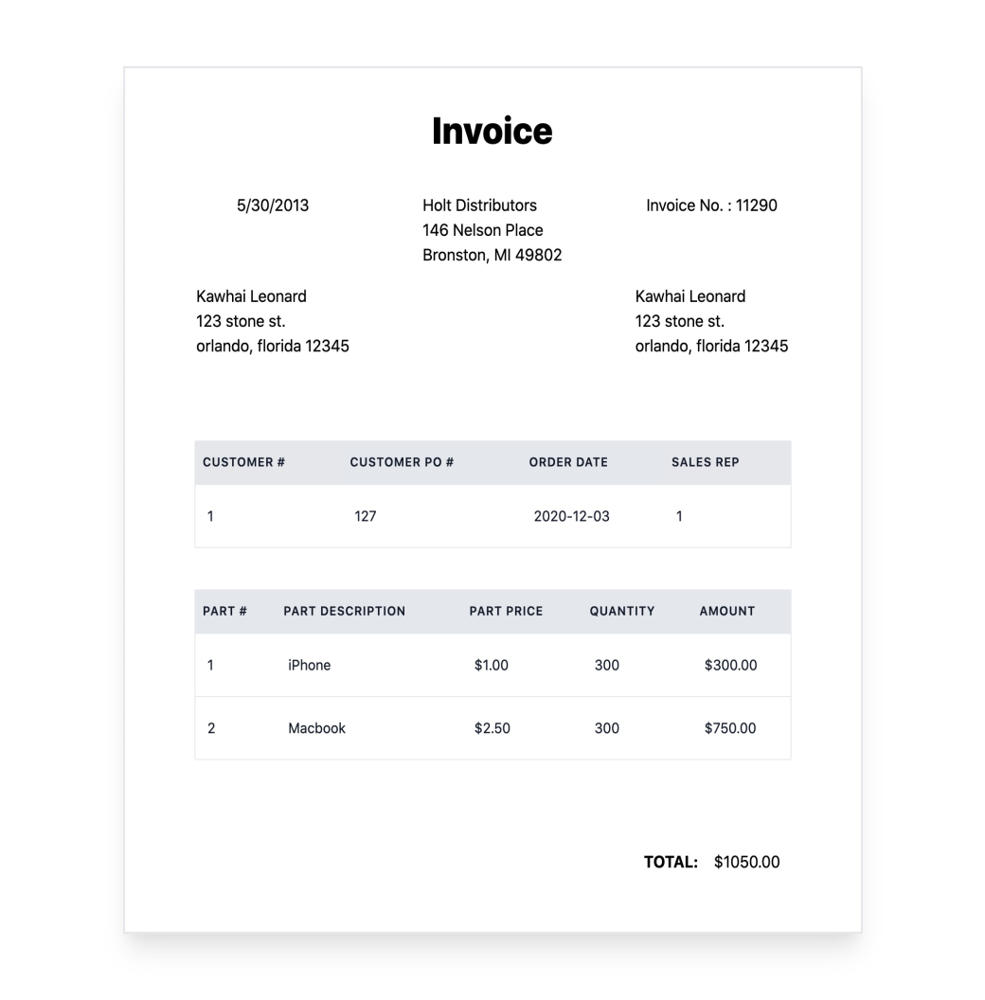

Slide 9
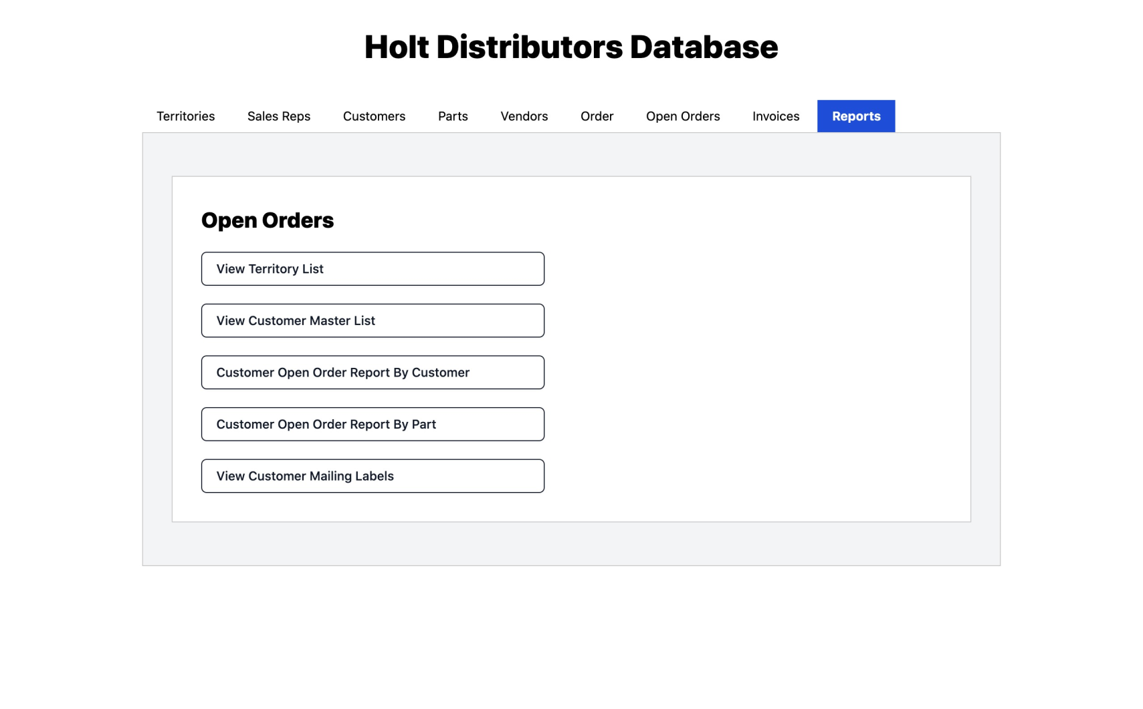

Slide 10
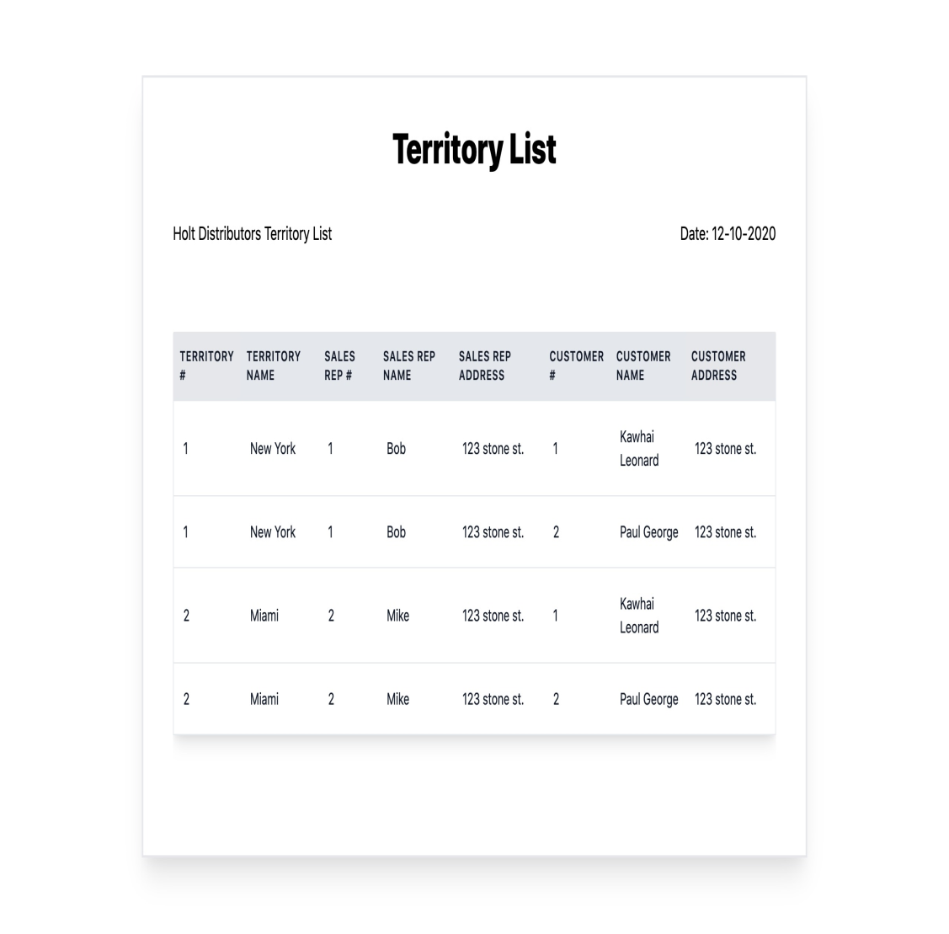
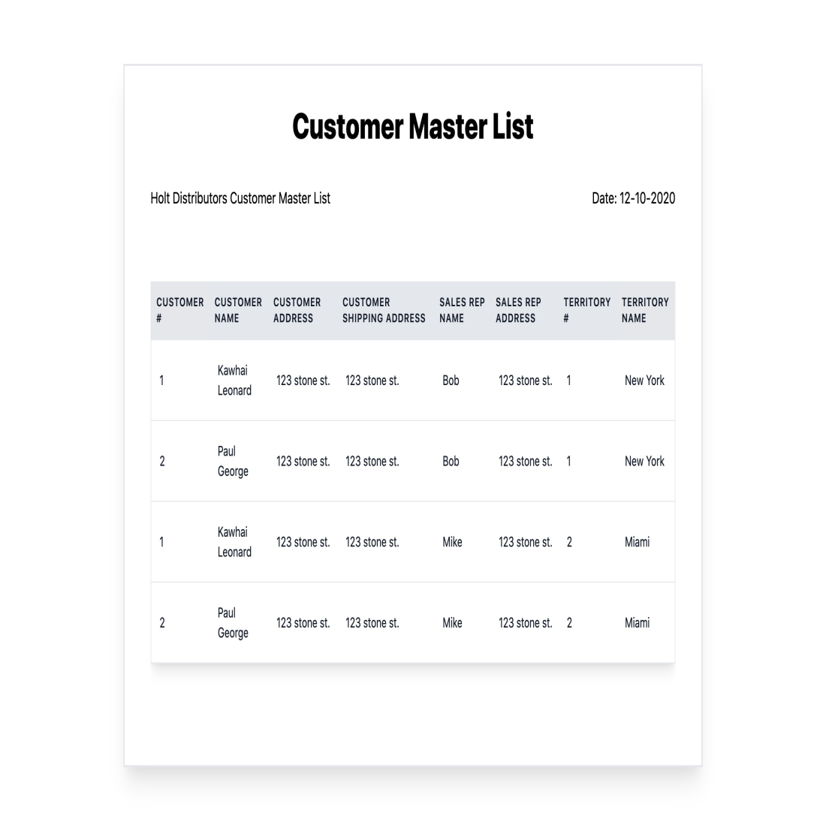

Slide 11
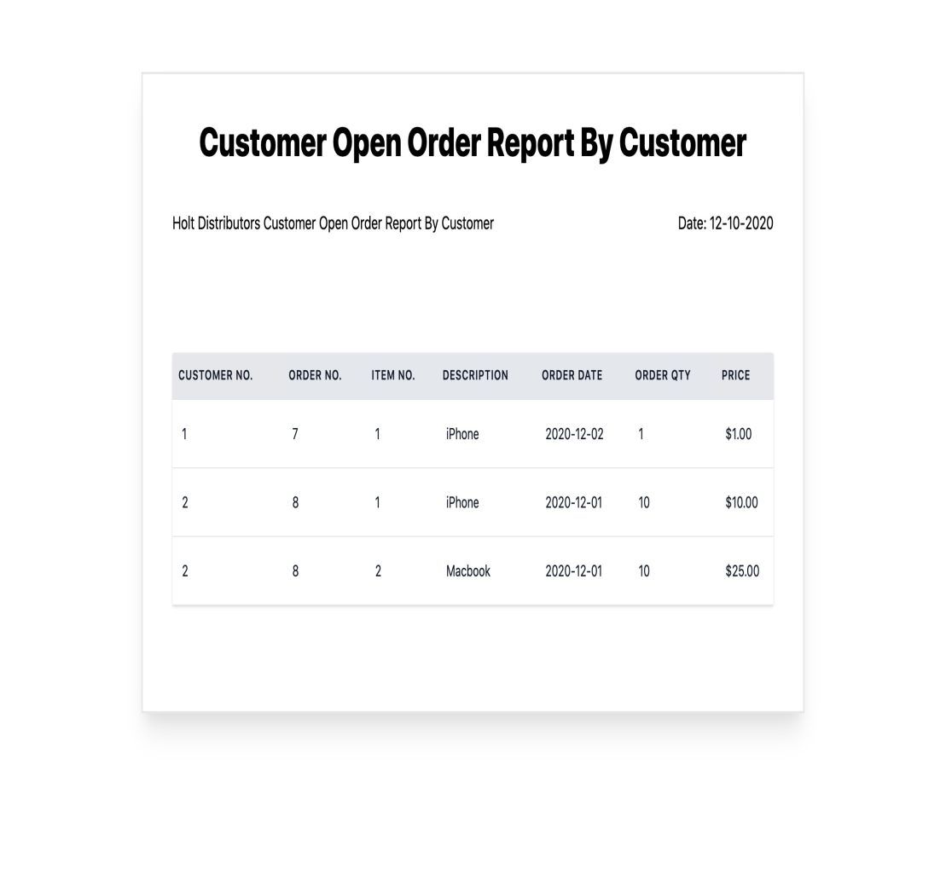
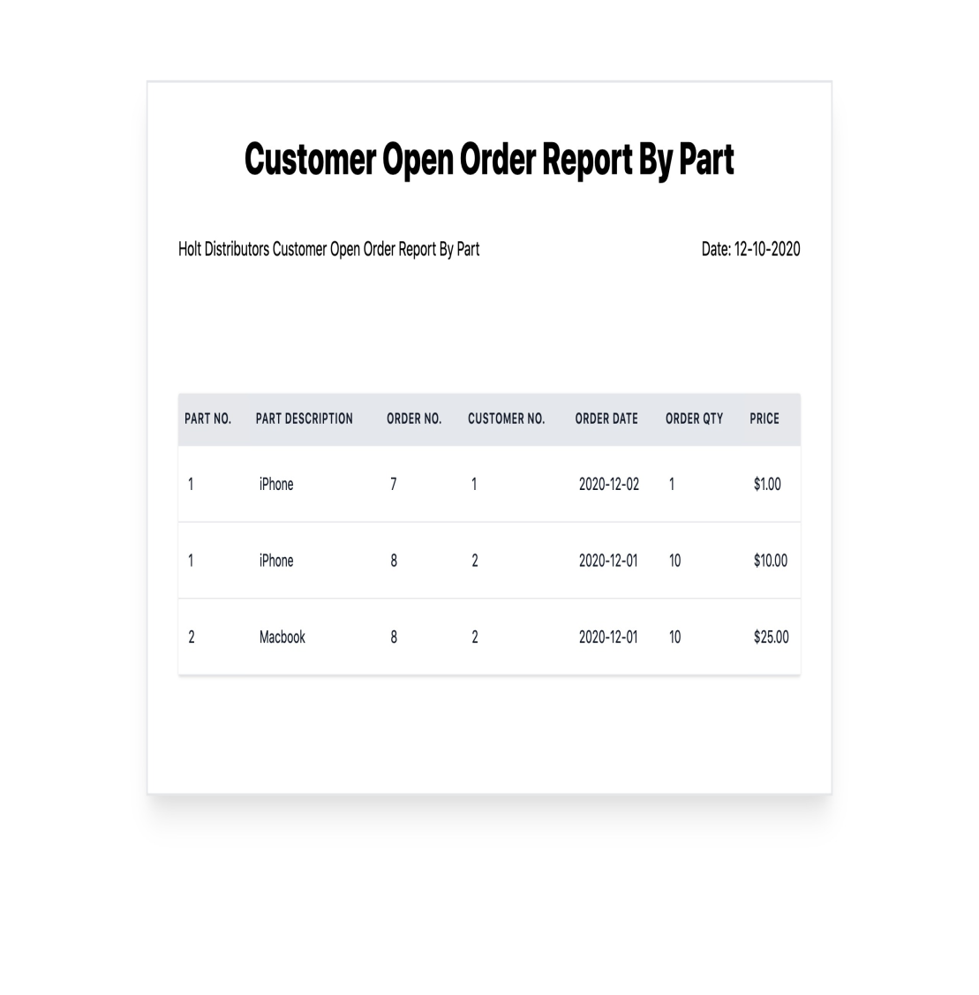

Slide 12
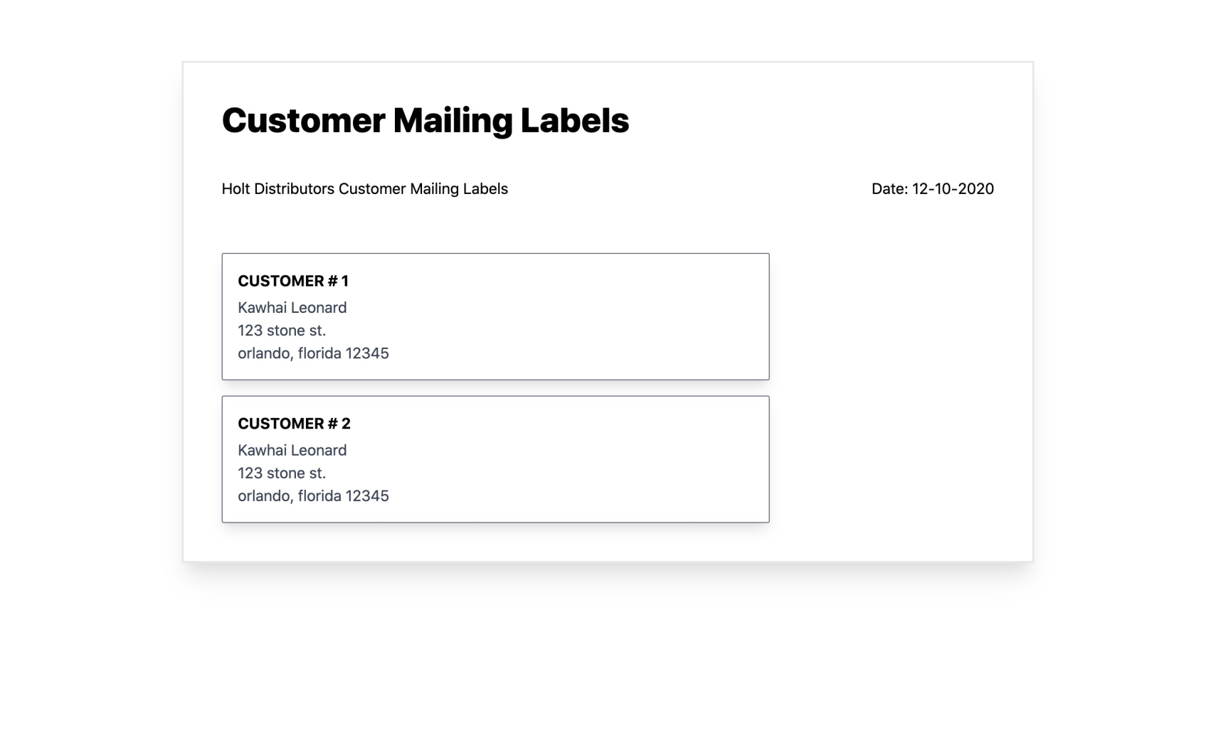

Slide 13
Database design :
This document contains the queries used in generating tables.
DB Queries

Slide 14
Coding :
Here we have a link to GitHub contain our code.
https://github.com/damontian1/csci-760-database-project

Slide 15
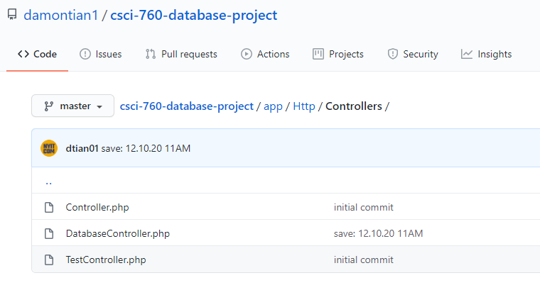
Here we have the database related data:

Slide 16
End of Slides

